Slide 1
COASTLINE DUAL ENROLLMENT PROGRAMS
Spring 2020 Update

Slide 2
Local Partnerships
2013–2014
Credits for College (Newport-Mesa Unified)
2016–2017
Early College High School (Newport-Mesa Unified)
2018–2019
College & Career Access Pathways Partnership (Garden Grove Unified School District)

Slide 3
Dual Enrollment Goals from the Student’s Perspective
Complete subject requirements for high school graduation and university admission eligibility
Pursue advanced academic opportunities
Save time and money with tuition-free college classes
Develop college and career navigational ability
Early “pathing” on future college and career roadmaps

Slide 4
Courses offered through a partnership (non-ECHS)
 | Sections | Enrollments | Success Rates | Units Earned
2016-17 | 6 | 84 | 77.4% | 195
2017-18 | 8 | 169 | 74.0% | 375
2018-19 | 8 | 150 | 77.3% | 348
2019-20 | 21 | 430 | 83.6% * | 459 *
* Data only from the 8 sections offered in Summer & Fall 2019

Slide 5
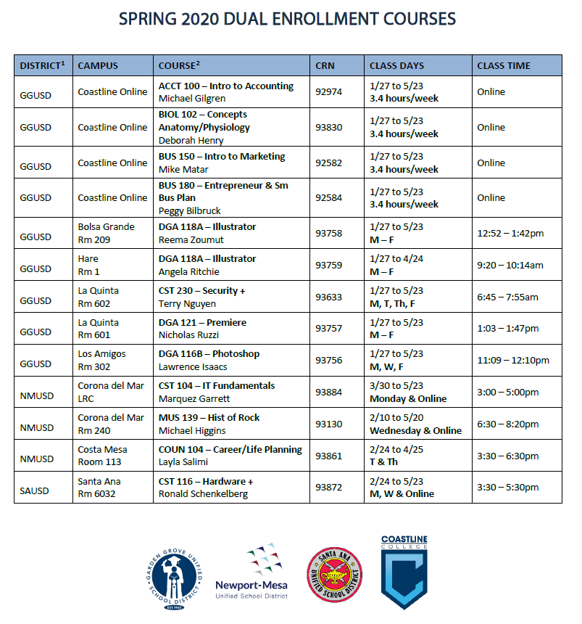

Slide 6
EARLY COLLEGE HIGH SCHOOL
Public high school in the Newport-Mesa District
Classes at high school campus during regular day, taught by Coastline faculty (9 adjuncts and 3 full-time)
Average 220 total students per year
62% Hispanic/Latinx, 27% White, 8% Asian
67% Socioeconomically Disadvantaged
100% HS Graduation Rate
Student typically completes 21 Coastline units by high school graduation

Slide 7
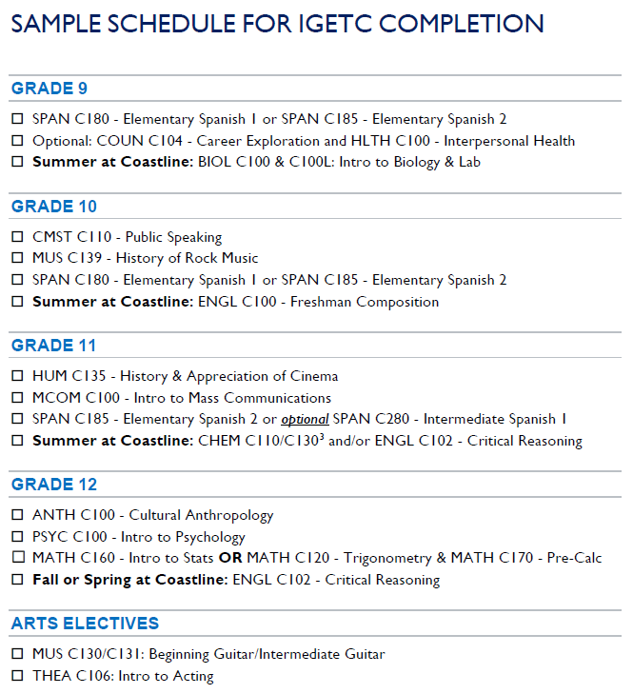

Slide 8
 | Sections | Enrollment | Class size | Success | Units Earned | Full IGETC | Partial IGETC
2015-16 | 26 | 606 | 23 | 83.6% | 1698 | 1 | 0
2016-17 | 28 | 598 | 21 | 89.4% | 1743 | 0 | 0
2017-18 | 31 | 619 | 20 | 85.7% | 1758 | 4 | 0
2018-19 | 28 | 572 | 20 | 86.7% | 1638 | 9 | 1
2019-20 | 25 | 541 | 22 | 87.5% * | 592 * | 7 ** | 3 **
* Fall 2019 data only
** End-of-year projection

Slide 9
SUCCESS IN IGETC COURSES (2015-16 to 2018-19)

Slide 10
TRENDS & TAKEAWAYS
Dual enrollment is looked at by both colleges and high schools to offset softening enrollment numbers.
Partnerships increase access to college and career pathways at zero cost to the student.
HS students see a path to competitive careers and universities with dual enrollment.
Coastline can establish firm presence in community by expanding high school programs. Consider:
Short certificates for HS students
Curriculum alignment with HS partners to ensure seamless transition
Progress monitoring for dual enrollees (especially at scale)
Summer enrichment/preparation for college English and Math

Slide 11
Donovan Bui Dual Enrollment Director dbui23@coastline.edu

